Slide 1
Lecture 7 The normal distribution, Z-scores, Transformations of Variables

Slide 2
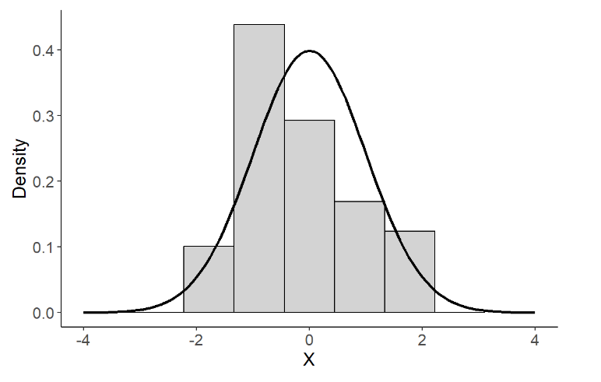
Density Curves

Slide 3
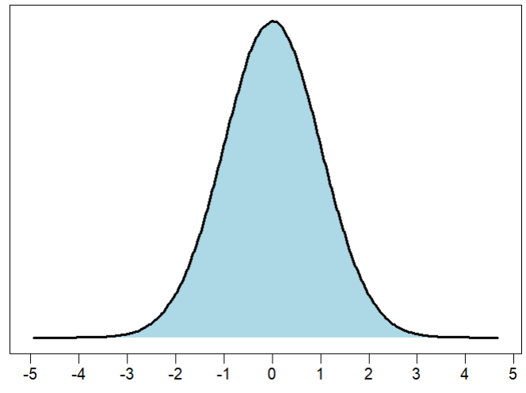
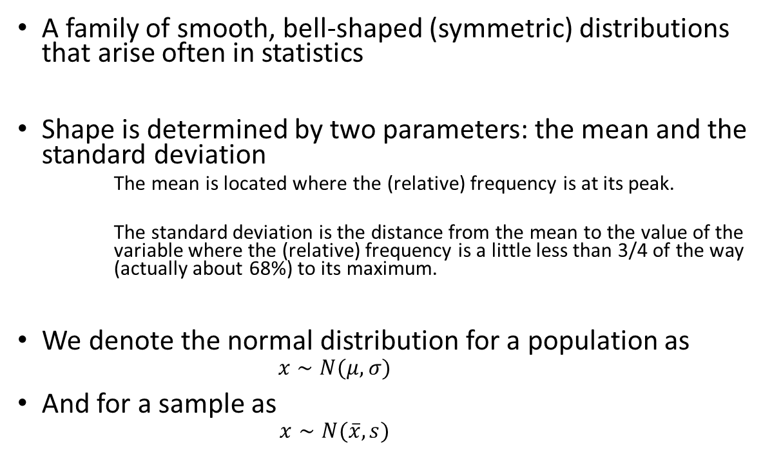
The Normal Distribution
A family of smooth, bell-shaped (symmetric) distributions that arise often in statistics
Shape is determined by two parameters: the mean and the standard deviation
The mean is located where the (relative) frequency is at its peak.
The standard deviation is the distance from the mean to the value of the variable where the (relative) frequency is a little less than 3/4 of the way (actually about 68%) to its maximum.
We denote the normal distribution for a population as
$$x∼N(μ, σ)$$
And for a sample as
$$x∼N(\overline{x}, s)$$

Slide 4
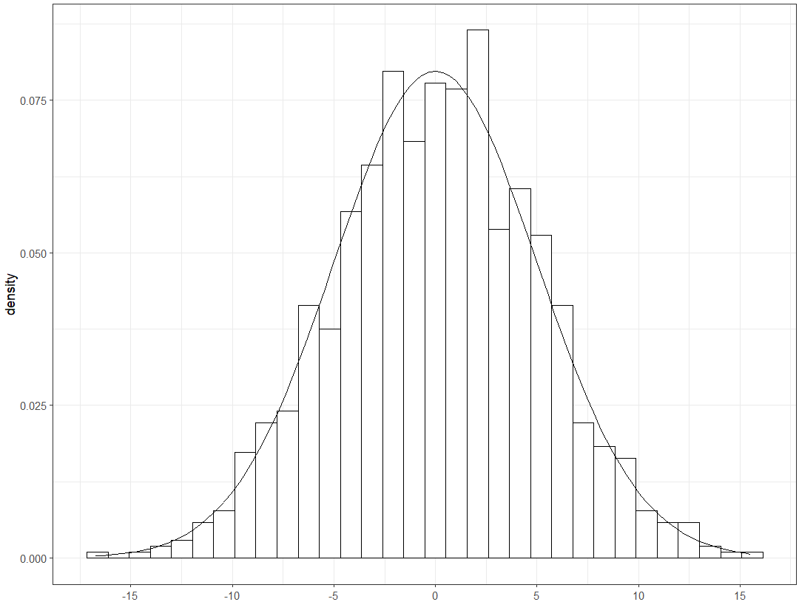
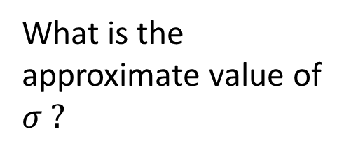

What is the approximate value of $σ ?$
$$σ=5$$

Slide 5
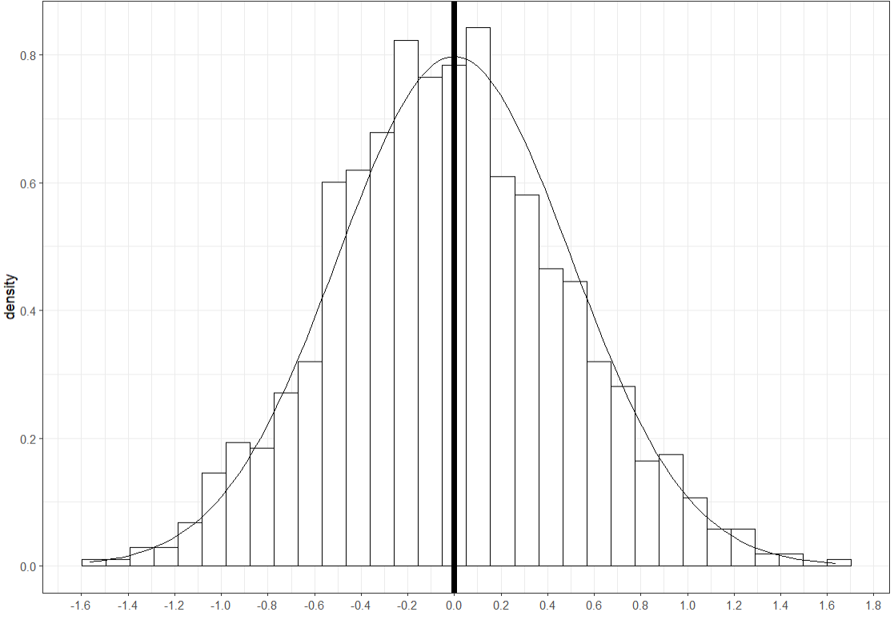
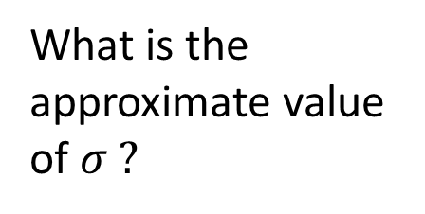

What is the approximate value of $σ ?$
$$σ=0.5$$

Slide 6
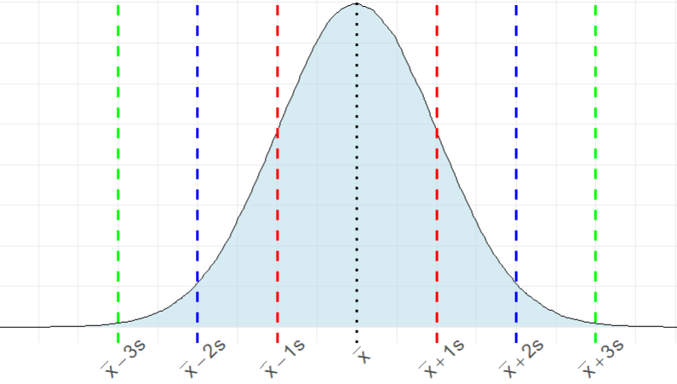
The Empirical Rule
About 99.7% of the data
About 95% of the data
About 68% of the data
2.35%
13.5%
34%
34%
13.5%
2.35%

Slide 7
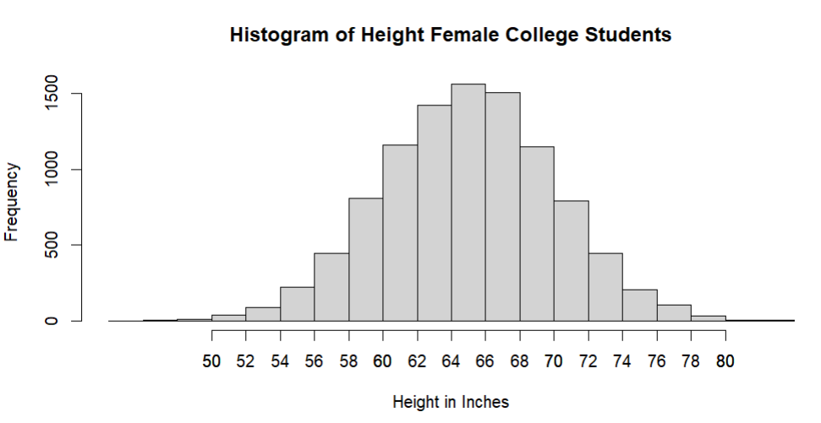
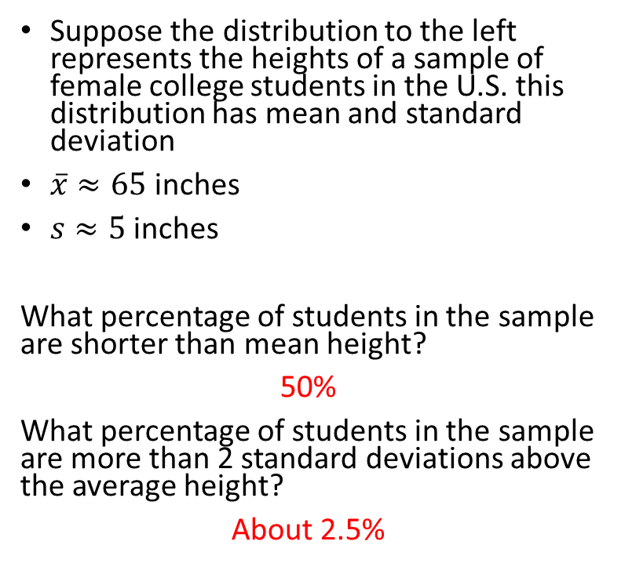
Practice
Suppose the distribution to the left represents the heights of a sample of female college students in the U.S. this distribution has mean and standard deviation
$\overline{x}≈65$ inches
$s≈5$ inches
What percentage of students in the sample are shorter than mean height?
50%
What percentage of students in the sample are more than 2 standard deviations above the average height?
About 2.5%
0.15%
2.35%
13.5%
34%

Slide 8
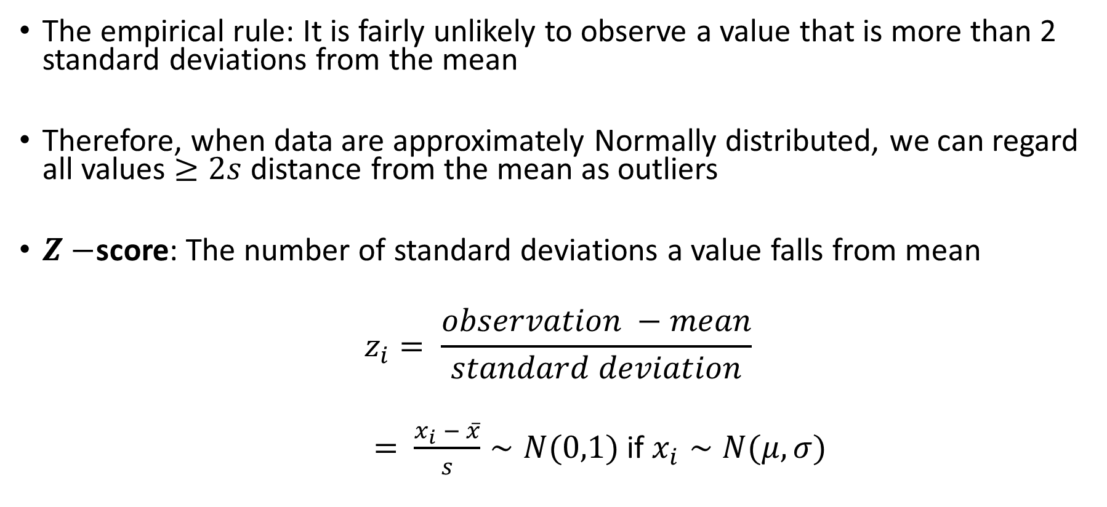
Identifying Outliers: Normal Distributions
The empirical rule: It is fairly unlikely to observe a value that is more than 2 standard deviations from the mean
Therefore, when data are approximately Normally distributed, we can regard all values $≥2s$ distance from the mean as outliers
$Z−$score: The number of standard deviations a value falls from mean
$$z_{i}= \frac{observation −mean}{standard deviation}$$
$= \frac{x_{i} − \overline{x}}{s}∼N(0,1)$ if $x_{i}∼N(μ, σ)$

Slide 9
What is the approximate value of $σ ?$
$$σ=5$$

Slide 10
What is the approximate value of $σ ?$
$$σ=0.5$$

Slide 11
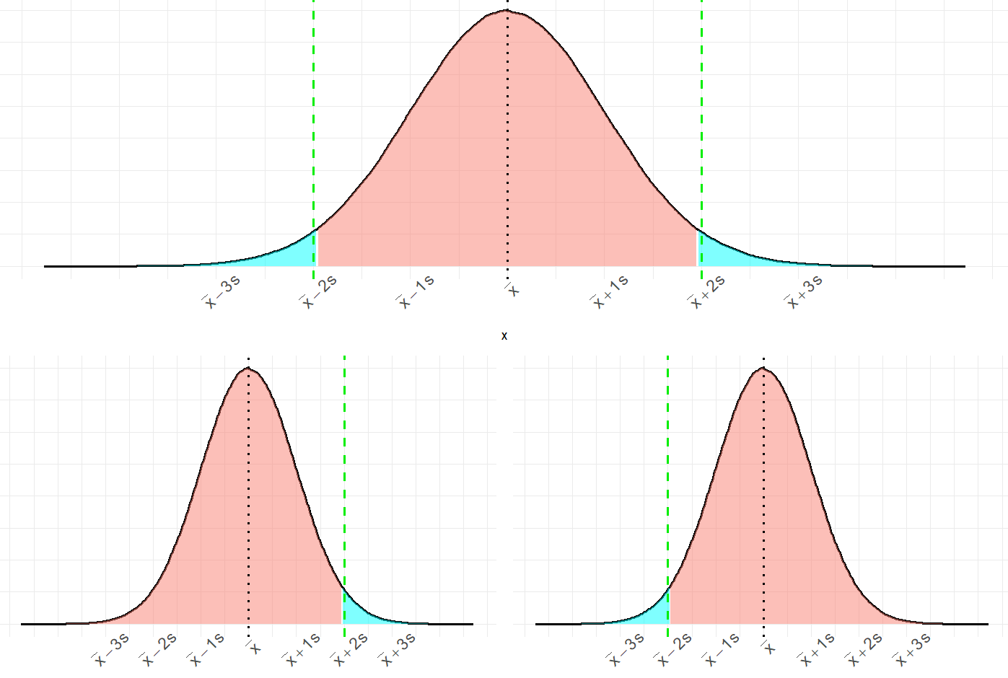
Outliers
Outliers
95%
2.5%
2.5%
Upper tail
Lower tail
97.5%
2.5%
2.5%
97.5%

Slide 12
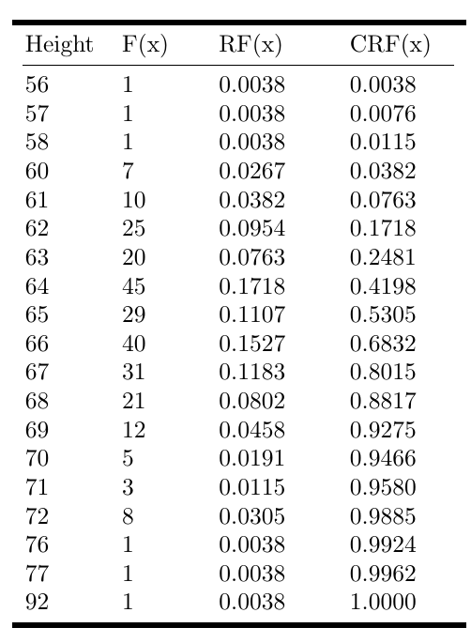
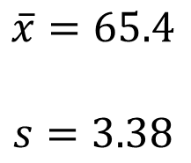
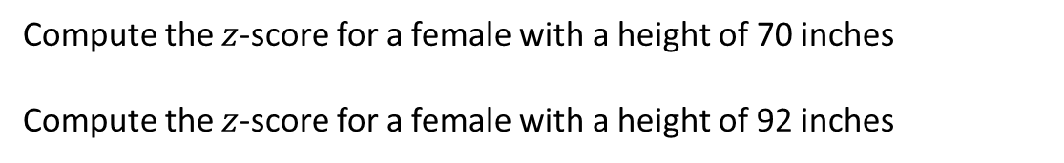
Try it out: Female College Student Heights
Compute the $z$-score for a female with a height of 70 inches
Compute the $z$-score for a female with a height of 92 inches
$$\overline{x}=65.4$$
$$s=3.38$$

Slide 13
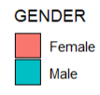
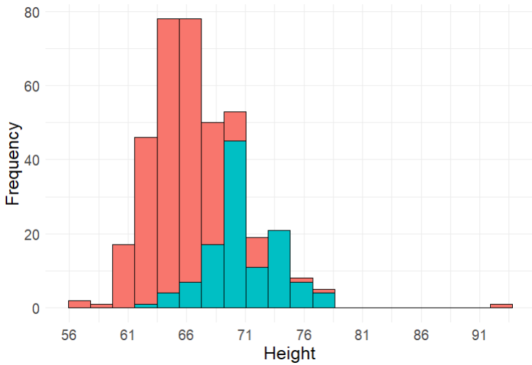
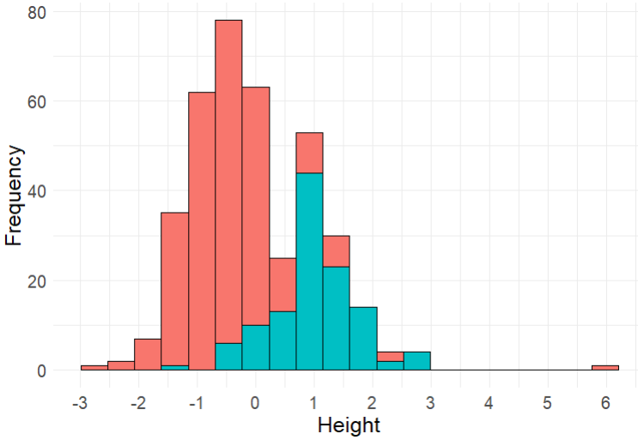
College Student Heights

Slide 14
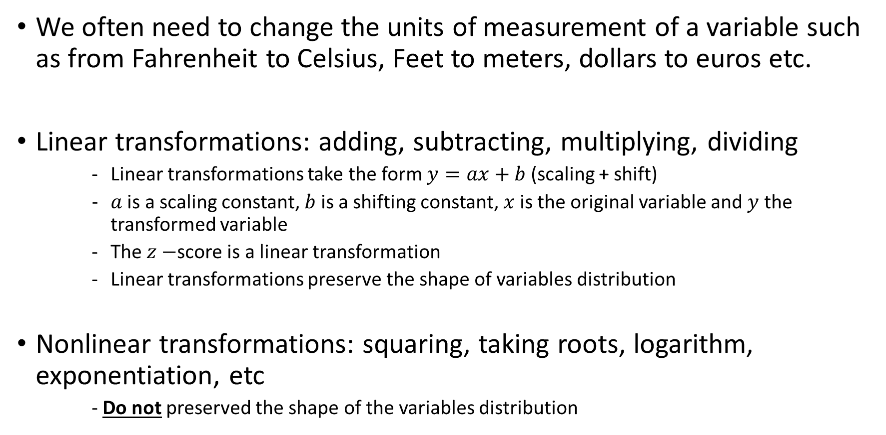
A Note About Transformations of Variables…
We often need to change the units of measurement of a variable such as from Fahrenheit to Celsius, Feet to meters, dollars to euros etc.
Linear transformations: adding, subtracting, multiplying, dividing
Linear transformations take the form $y=ax+b$ (scaling + shift)
$a$ is a scaling constant, $b$ is a shifting constant, $x$ is the original variable and $y$ the transformed variable
The $z−$score is a linear transformation
Linear transformations preserve the shape of variables distribution
Nonlinear transformations: squaring, taking roots, logarithm, exponentiation, etc
- Do not preserved the shape of the variables distribution

Slide 15
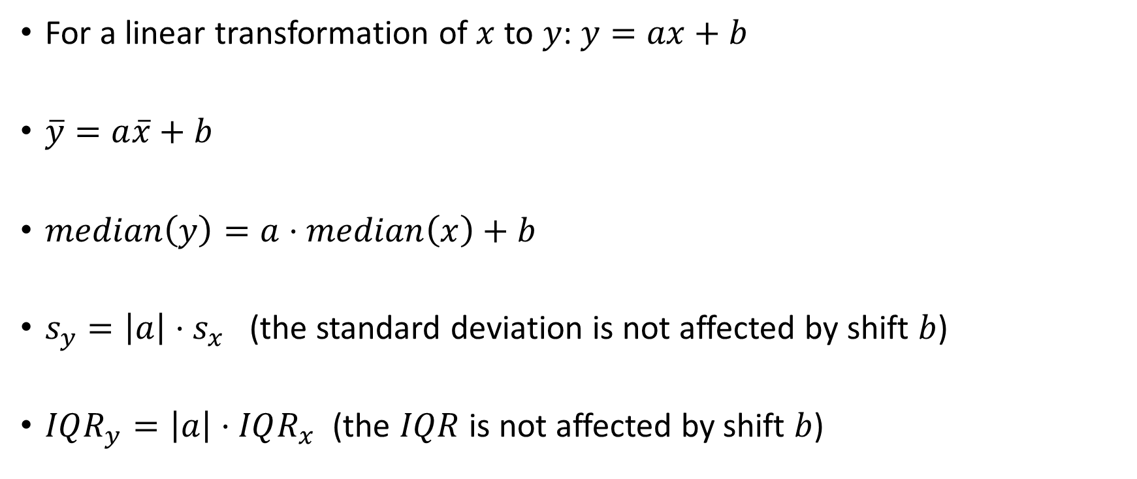
More properties of Linear Transformations
For a linear transformation of $x$ to $y$: $y=ax+b$
$\overline{y}=a\overline{x}+b$
$median\left(y\right)=a⋅median\left(x\right)+b$
$s_{y}=\left|a\right|{⋅s}_{x}$ (the standard deviation is not affected by shift $b$)
$IQR_{y}=\left|a\right|⋅IQR_{x}$ (the $IQR$ is not affected by shift $b$)

Slide 16
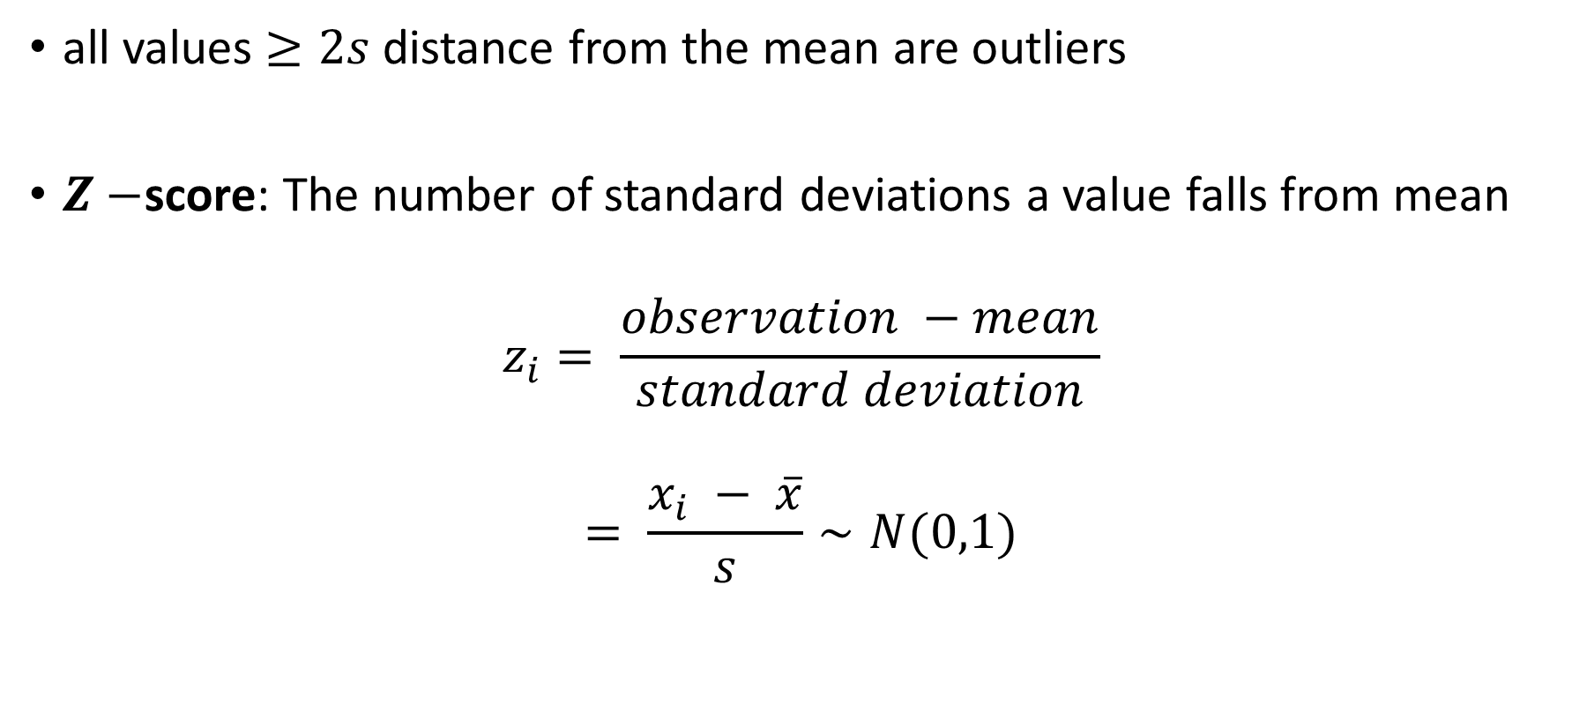
Identifying Outliers: Normal Distributions
all values $≥2s$ distance from the mean are outliers
$Z−$score: The number of standard deviations a value falls from mean
$$z_{i}= \frac{observation −mean}{standard deviation}$$
$$= \frac{x_{i} − \overline{x}}{s}∼N(0,1)$$

Slide 17
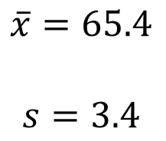
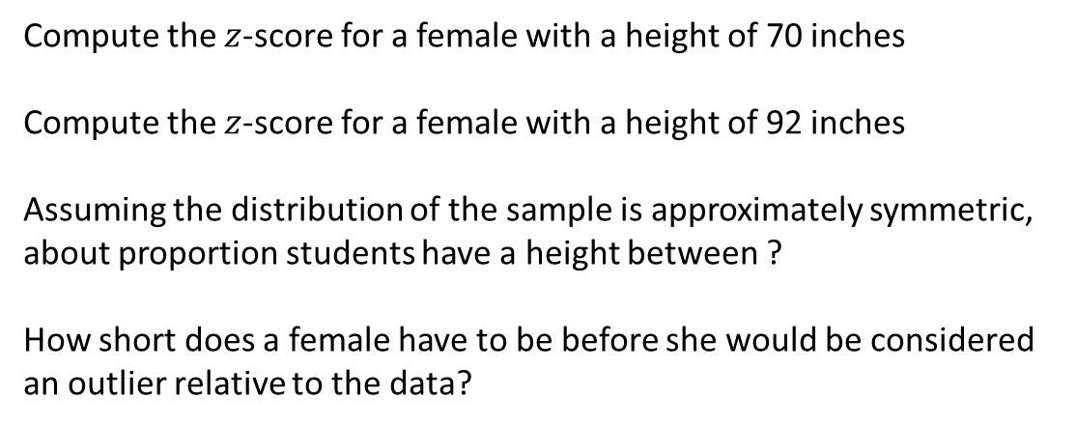
Try it out: Female College Student Heights
Compute the $z$-score for a female with a height of 70 inches
Compute the $z$-score for a female with a height of 92 inches
Assuming the distribution of the sample is approximately symmetric, about proportion students have a height between ?
How short does a female have to be before she would be considered an outlier relative to the data?
$$\overline{x}=65.4$$
$$s=3.4$$

Slide 18
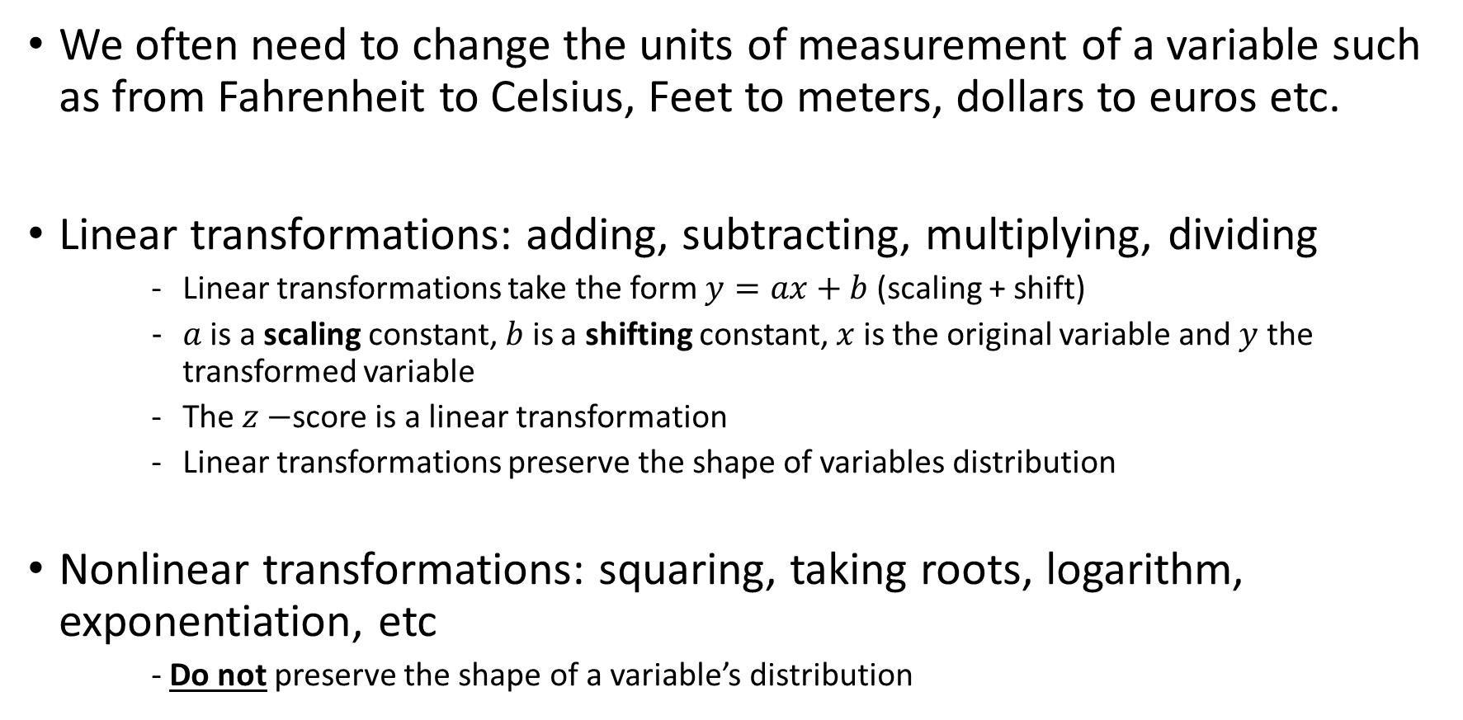
A Note About Transformations of Variables…
We often need to change the units of measurement of a variable such as from Fahrenheit to Celsius, Feet to meters, dollars to euros etc.
Linear transformations: adding, subtracting, multiplying, dividing
Linear transformations take the form $y=ax+b$ (scaling + shift)
$a$ is a scaling constant, $b$ is a shifting constant, $x$ is the original variable and $y$ the transformed variable
The $z−$score is a linear transformation
Linear transformations preserve the shape of variables distribution
Nonlinear transformations: squaring, taking roots, logarithm, exponentiation, etc
- Do not preserve the shape of a variable’s distribution

Slide 19
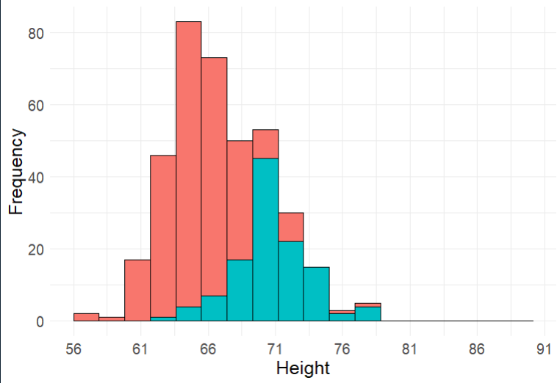
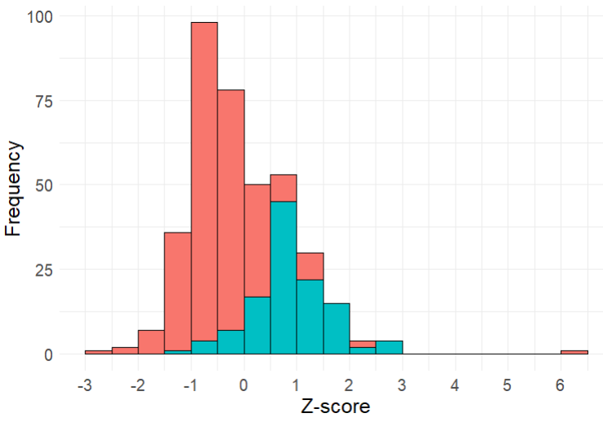
College Student Heights
Original Units
Z-score

Slide 20
More properties of Linear Transformations
For a linear transformation of $x$ to $y$: $y=ax+b$
$\overline{y}=a\overline{x}+b$
$median\left(y\right)=a⋅median\left(x\right)+b$
$s_{y}=\left|a\right|{⋅s}_{x}$ (the standard deviation is not affected by shift $b$)
$IQR_{y}=\left|a\right|⋅IQR_{x}$ (the $IQR$ is not affected by shift $b$)

Slide 21
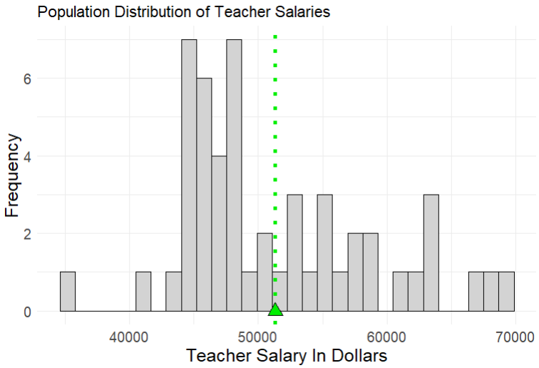
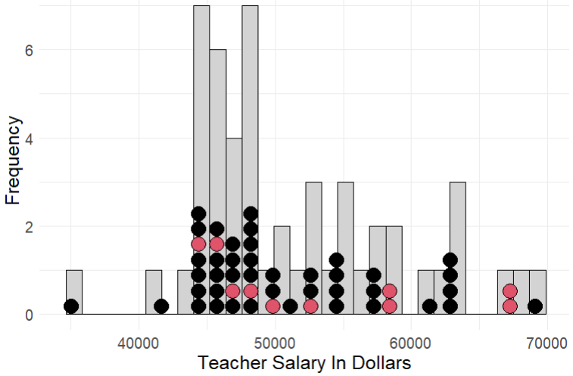
Sampling Distribution
Consider a survey to estimate the mean salary of high school teachers in a given school district. The goal of such a survey would be to use the mean from the sample of observations of teacher salaries (a statistic) as an estimate of the mean salary of the population of teachers in the entire school district (a parameter). This is an example of statistical inference.

Slide 22
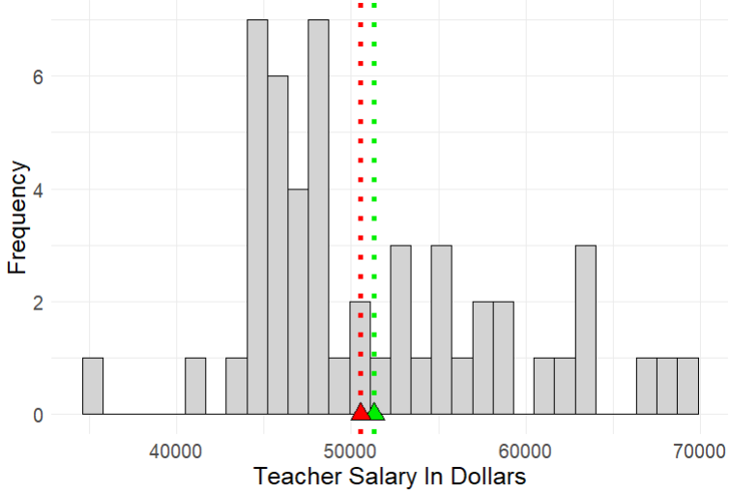
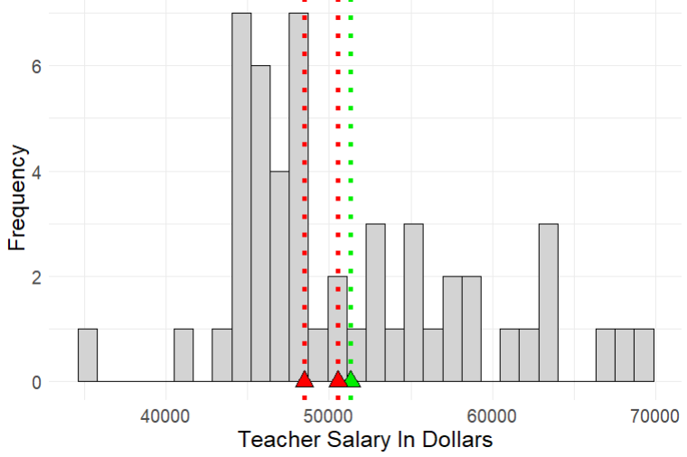
Sampling Distribution
Sample

Slide 23
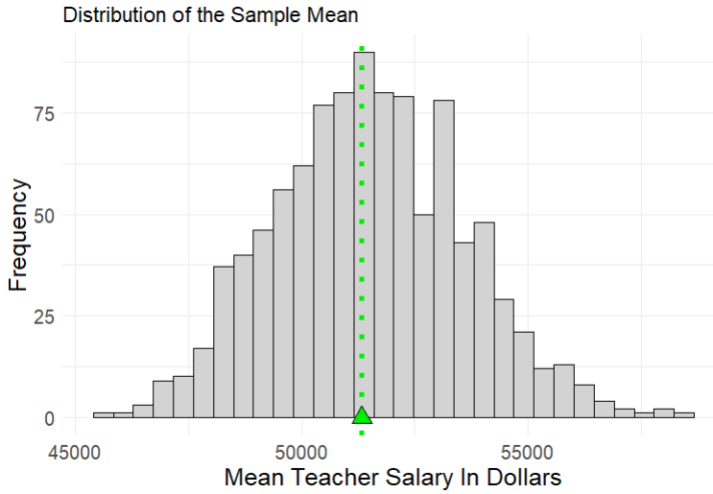
Margin of Error
The margin of error of an estimate measures how far we expect an estimate to fall from the true value of a population parameter
It is a measure of the between sample variability in our estimate
It is the largest distance between the true population parameter and an estimate that is not an outlier
Between sample variability

